Slide 1
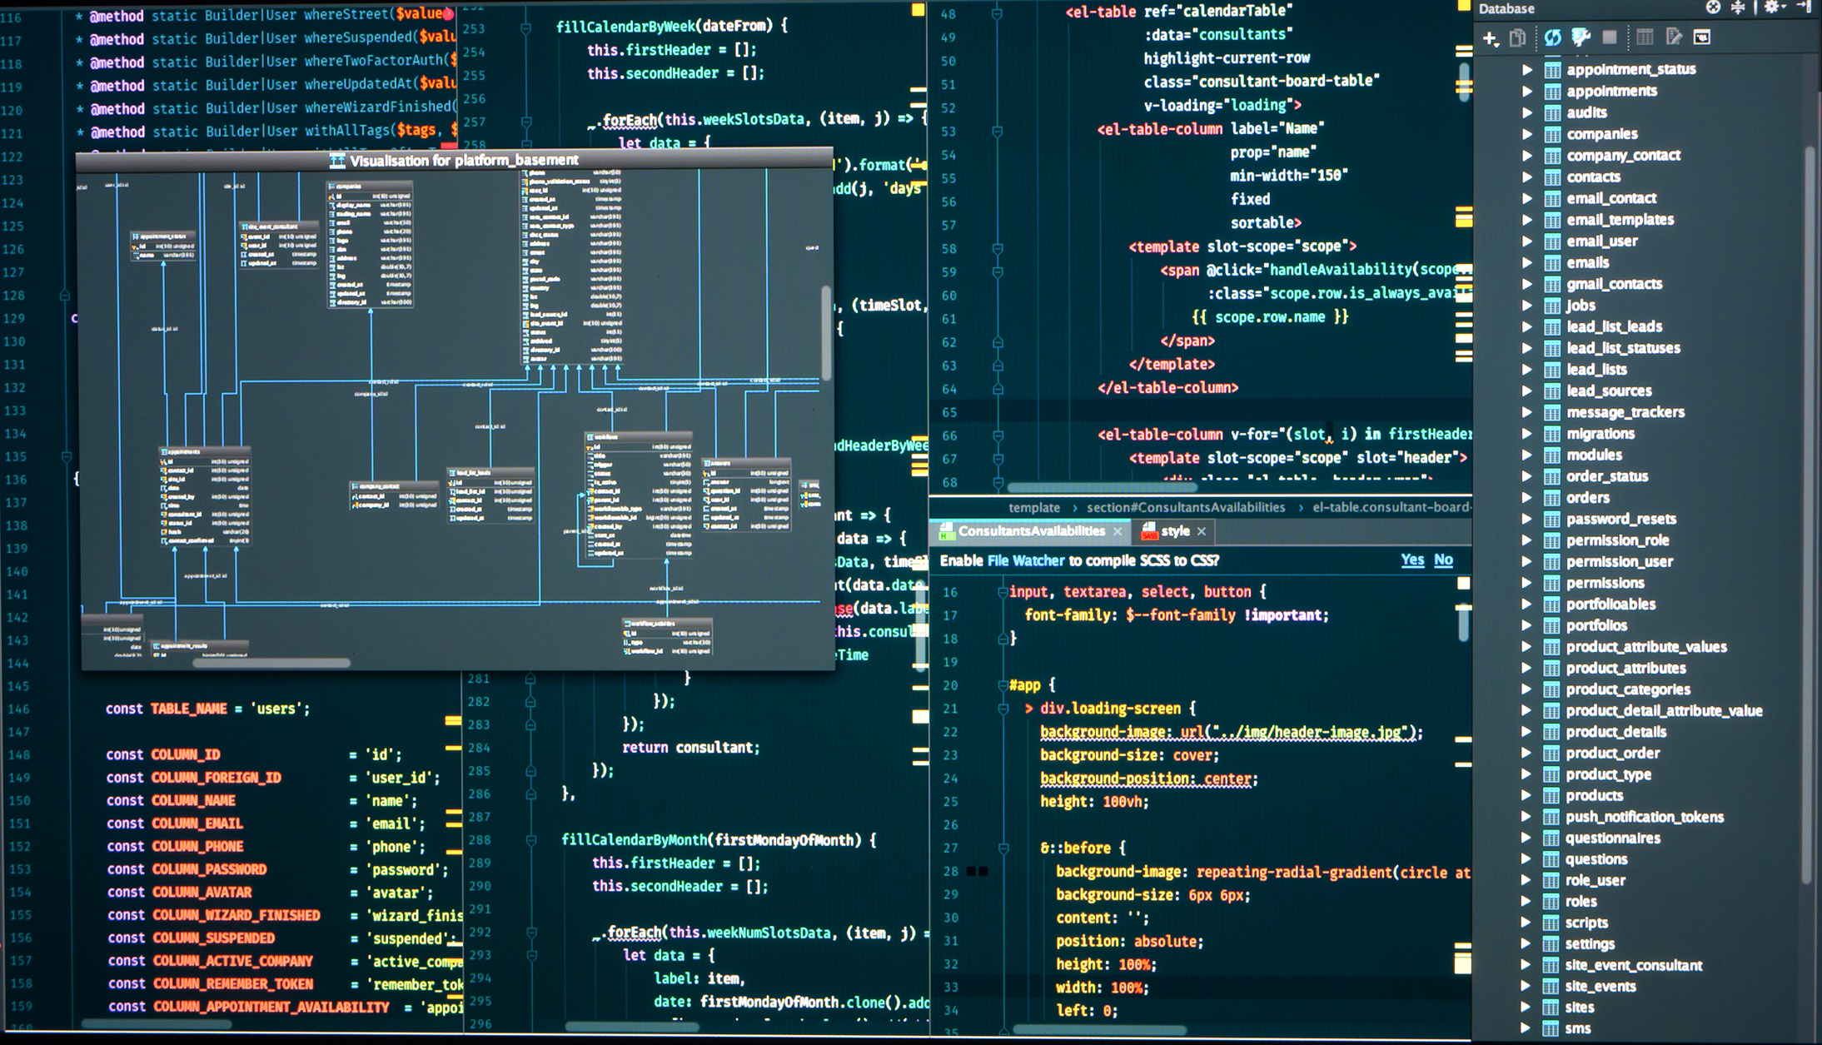
TIME MANAGEMENT SYSTEM
CSE 212 | DATABASE SYSTEMS LAB
PRESENTED TO
MOLLA RASHIED HUSSEIN
ASSISTANT PROFESSOR
PRESENTED BY
PARTHO
SHOHANA
TUSAR
SHAHTAZ
22201061
22201067
22201079
22201069

Slide 2
Theme
The Time Management System Database is created to help people stay on top of their tasks and responsibilities. By organizing projects, deadlines, schedules, and meetings, it makes it easier to track progress and stay on track. Whether you're managing your personal time or overseeing a team's workflow, it helps ensure everything gets done efficiently and on time.

Slide 3
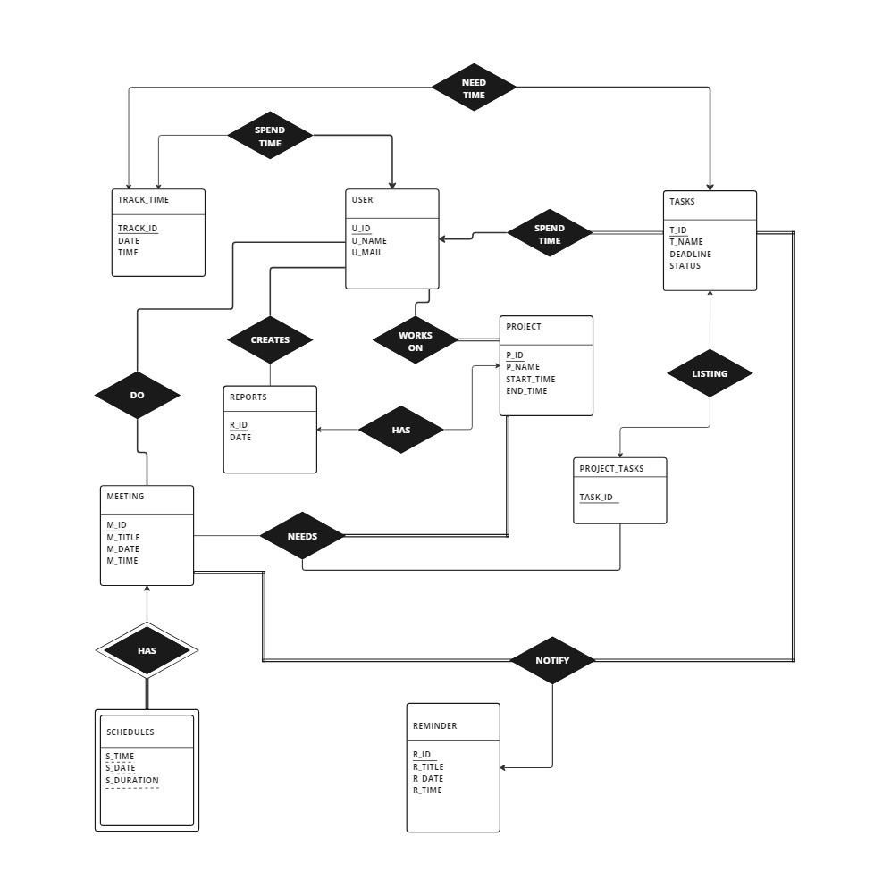
ER DIAGRAM
ENTITIES :
USERS
TASKS
TRACK TIME
REPORTS
PROJECT
MEETING
PROJECT TASKS
SCHEDULES
REMINDER

Slide 4
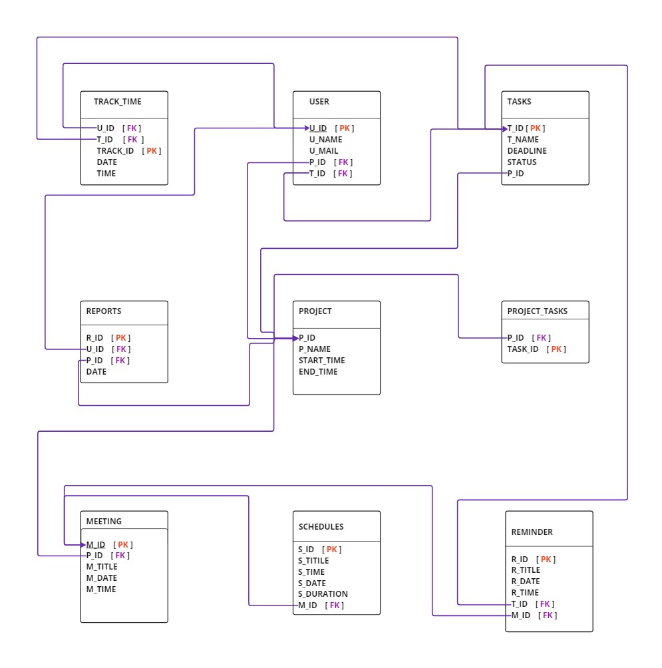
SCHEMA DIAGRAM

Slide 5
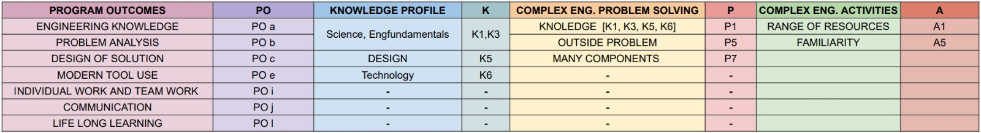
CEP MAPPING

Slide 6

THANK YOU !!

